Slide 1
Cross Band Repeating
by Christina Capurro Sand, WO1NDR
February 2, 2011

Slide 2
Why Cross Band Repeating?
Extends the range of HTs
Overcomes difficult terrain
  Skyscrapers
  Hills
  Valleys
  Ordinary repeaters are inaccessible

Slide 3
Two Methods
Cross Band Mode
  The repeater receives on either band and retransmits on the other.
Locked Band Mode (Kenwood)
  The repeater always receives on one band and transmits on the other.
Useful Resource/Explanation:
  http://www.cvarc.org/tech/crossband.html

Slide 4
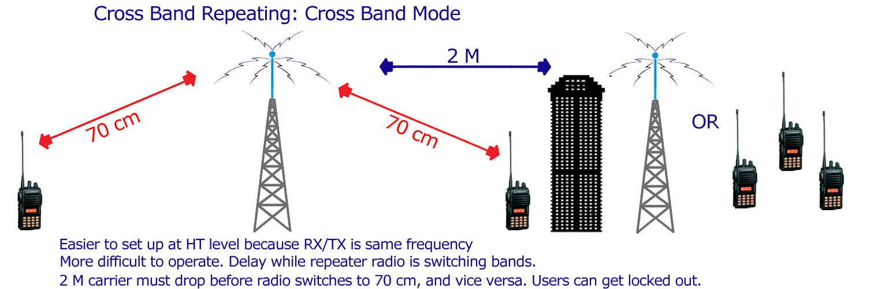
Cross Band Mode

Slide 5
Cross Band Mode
Advantages
  Easier for the end user to set up on their HT.
  Only one frequency/PL need be programmed.
  Some hams won’t have dual band HTs.
Disadvantages
  HT Users can be locked out if no radio discipline
    The carrier must drop before retransmitting on other band. Repeater takes time (a few seconds) to switch between bands and then retransmit.

Slide 6
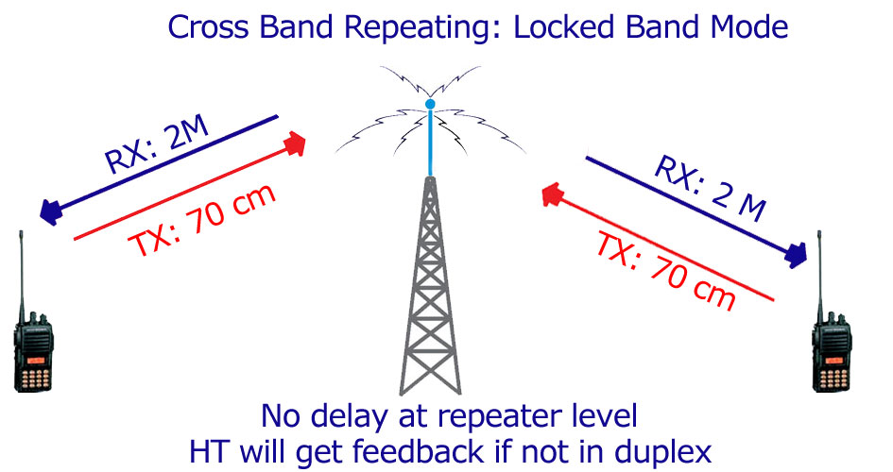
Locked Band Mode (Kenwood)

Slide 7
Locked Band Mode
Advantages
  There is no delay in retransmission at the repeater level.
  HT users won’t get locked out if no radio discipline.
Disadvantages
  More difficult for end user to program HT.
  Need to set both RX and TX frequencies.
  Need to set to DUPLEX or HT will get feedback. (Silence RX freq while TX’ing on other band.)
  End users MUST have a dual band HT.

Slide 8
Multiple Cross Band Repeaters
Multiple Cross Band Repeaters can be used in different zones of the same operation BUT
IF the CBRs are in Cross Band Mode…
Use a different input frequency for each repeater!!
OR you risk an HT in one zone hitting both repeaters simultaneously. This can lock up the repeaters.

Slide 9
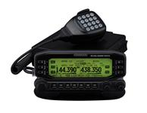
What Equipment is Needed?
Dual band mobile radios which can operate as a cross band repeater:
  Kenwood TM-D700
  Kenwood TM-D710
  Yaesu FT-8800R
  Yaesu FT-8900R
  Icom ?

Slide 10
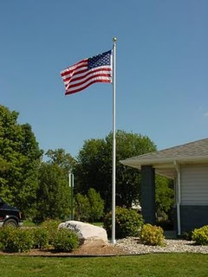

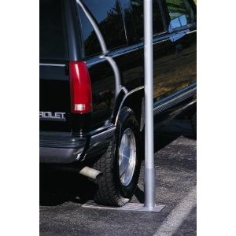
What Equipment is Needed?
Telescoping 20’ Aluminum Mast - $249; http://www.usaflagpoles.com/para/index.html?loadfile=catalog121_0.html)
High Gain, Dual Band Antenna (Diamond X50NA - ~$99; http://www.rfparts.com/diamond/x50na.html )
Coax (preferrably using an N connector)
Footing (Aluminum Wheelstand - $69; http://www.usaflagpoles.com/para/index.html?loadfile=catalog121_0.html )

Slide 11
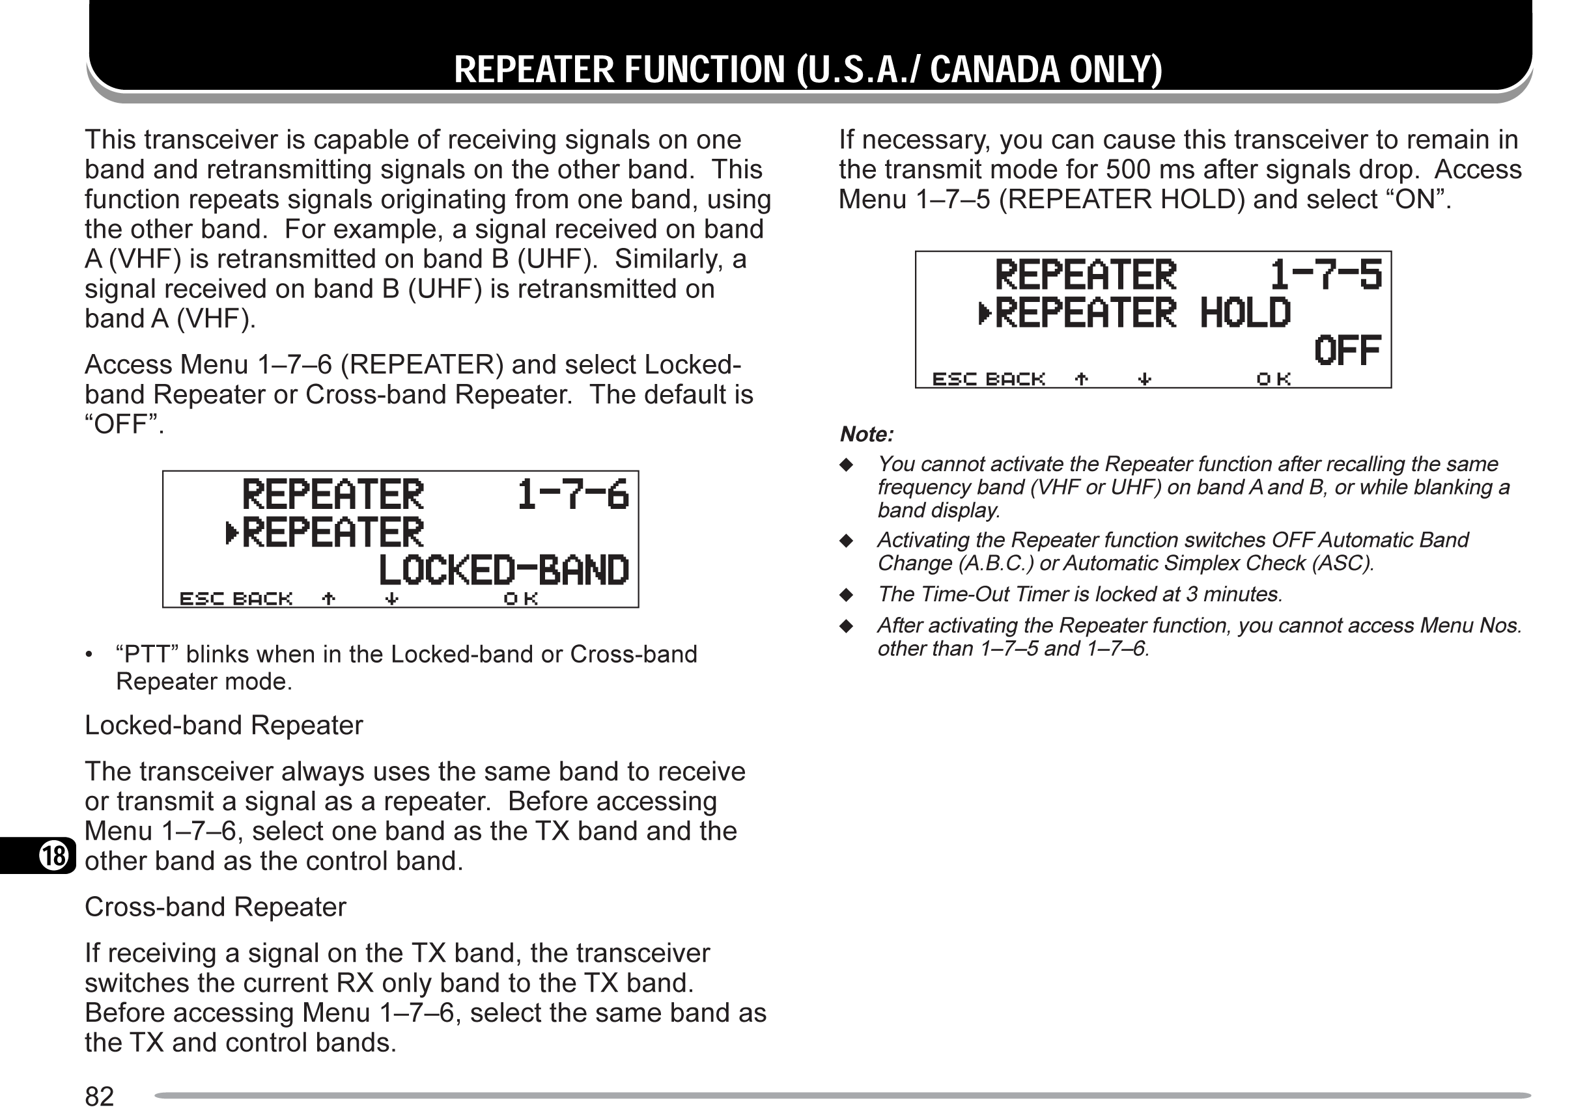
Programming Your Radio
(Kenwood TMD-700A)
N.B. All other functions (APRS, GPS, Packet, etc.) MUST be turned OFF or it will not go into the cross band repeat function.

Slide 12
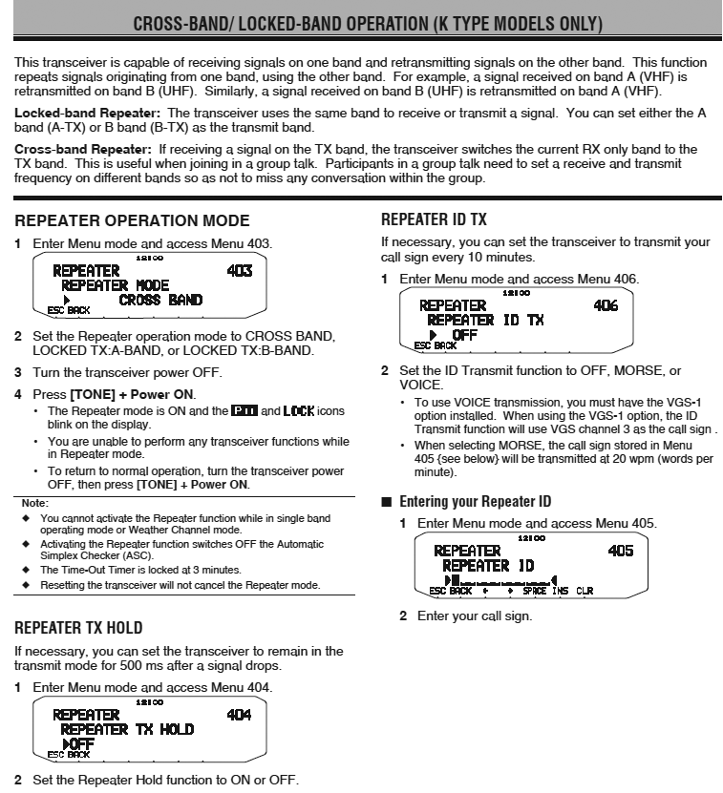
Programming Your Radio
(Kenwood TM-D710A)

Slide 13
Legal Considerations
Station Control
  FCC requires repeater to be under control of operator who can intervene if there is a problem.
  Control can be local or remote.
Station Identification
  Must identify on all frequencies on which it transmits.
  Use call sign of owner/operator followed by /r
  Some radios have capability for automated ID (Kenwood TM-D710A)

Slide 14
Programming Your HT
Cross Band Mode
  Select a band (it doesn’t matter which one).
  Program the appropriate frequency.
  Select a PL tone, if required.
  Use Low Power – you only have to make it to the CBR.
Locked Band Mode (Kenwood)
  Select Dual Band Mode
  Program the appropriate TX/RX frequencies (and PL tone, if required). Yaesu calls this “odd splits”.
  Select the TX band; the other band will be the RX band.
  Put the HT into DUPLEX or you will get feedback.
  Every HT is different. Some dual band HTs can’t DUPLEX. If that’s the case, go to the output of the CBR.
  Use Low Power.

Slide 15
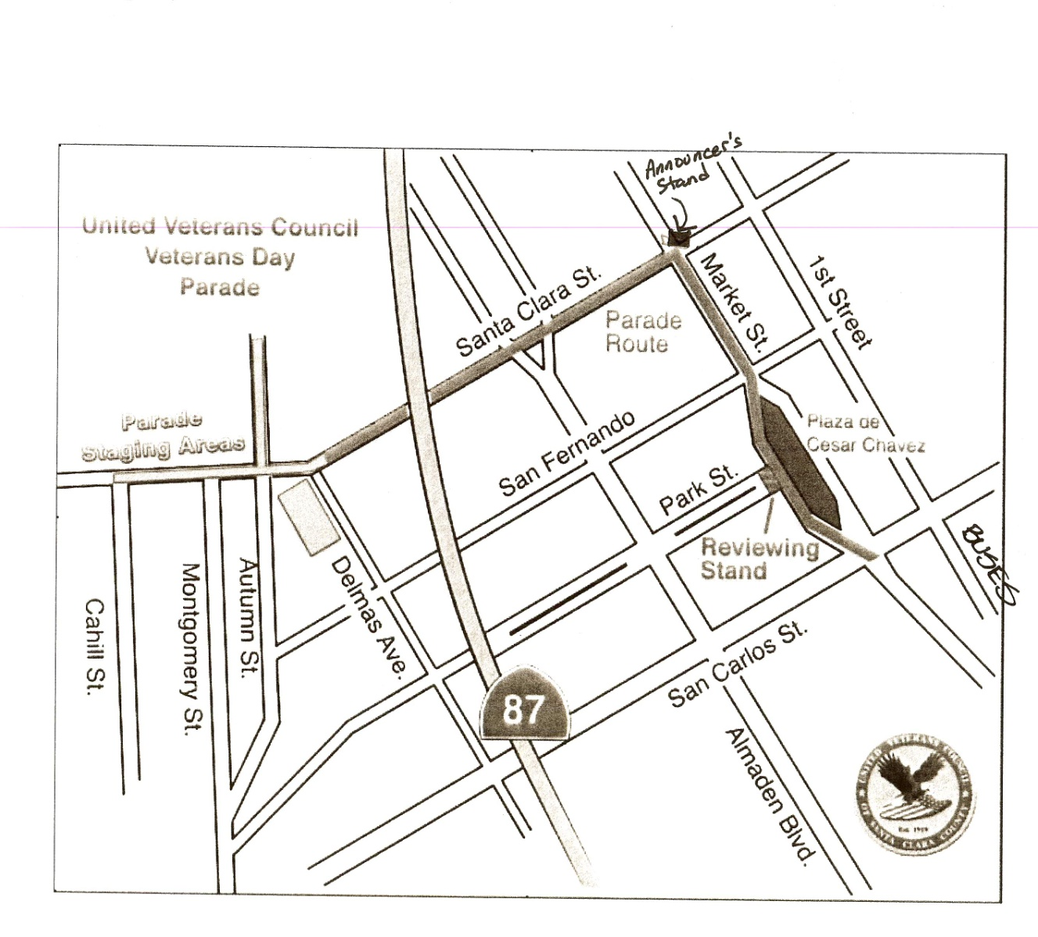
Veterans Day Parade
Zone 1 (Staging Area)
CBR with input of 446.175, PL 100 and output of 146.475, PL 100.
Operating positions in this zone used dual band HTs with TX frequency set to 446.175, PL 100, and RX frequency of 146.475, PL 100 (TAC 1).
Zone 2 (Parade Route)
CBR with input of 446.500, PL 100 and output of 146.475, PL 100.
Operating positions in this zone used dual band HTs with TX frequency set to 446.500, PL 100 and RX frequency of 146.475, PL 100 (TAC1).

